Slide 1
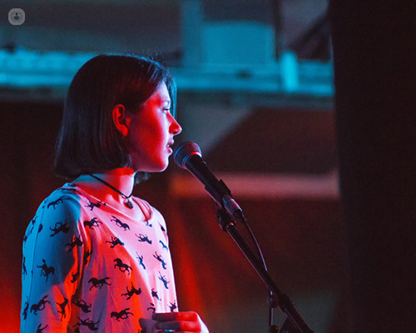
Verbal Communication

Slide 2
Oral communication
Department of English
Faculty of Social Sciences
College of Humanities and Social Sciences
Kwame Nkrumah University of Science and Technology
Stage fright
Chairperson’s remarks
Vote of Thanks
Proposal of Toast
Interview

Slide 3
Objectives
By the end of the lesson, the students will be able to:
Demonstrate knowledge and understanding of oral communication
Give and explain different types of formal oral presentation used in Business/corporate communication and our everyday interactions.
Identify the stages or process involved in any of the oral presentations.
Show confidence in public speaking.

Slide 4
Oral/Verbal Communication Definition
Oral Communication is a type of communication which employs the spoken word, either direct or indirect as a communication channel.
Oral communication implies communication through mouth.
It includes individuals conversing with each other either direct conversation, or face-to-face, or over the phone, or via voice notes or chat rooms, etc.
Classroom oral presentation and discussions, dramatization, poetry recital, vote of thanks, interview etc. are examples of oral communication.

Slide 5
Characteristics of Effective Oral Communication
The following are some characteristics of an effective oral /verbal communication:
Completeness: Effective communication is complete, that is the receiver gets all the information he/she needs to process the message and take action.

Slide 6
Characteristics Cont.
Conciseness: Conciseness is about keeping the message to a point.
Conciseness helps the listeners to focus on what is important, speed up the processing of information, and cater for improved understanding.

Slide 7
Characteristics Cont.
Concreteness: A concrete message is specific, tangible and vivid.
It is supported by facts and figures for enhanced trustworthiness.
It helps your listeners gain an overview of the broader picture and deals the risk of misunderstanding, fosters trust and encourages constructive criticism.

Slide 8
Characteristics Cont.
Courtesy: Courtesy and consideration complement each other in effective communications.
Courtesy means respecting the receiver’s culture, values and beliefs – i.e. crafting a message that is genuinely polite and unbiased.
The presenter should try his/her best to be honest, respectful, considerate, open and polite with the receiver of the information.
The message when supplemented with proper care and kindness will definitely find an audience.

Slide 9
Characteristics Cont.
Clearness: The clearer the message, the easier it gets the receiver to decode it according to the original intent.
To deliver an effective oral communication, start with a clear goal and accurate thoughts.
Clear communications build on exact language use and concrete words to reduce ambiguities and confusion in the communication process.
Effective communication is about delivering an information unambiguously, so that the receiver can decode it correctly.

Slide 10
Characteristics Cont.
Correctness: Correct grammar and syntax guarantee effectiveness and credibility of your message.
Formal errors might affect the clarity of your message, bring about ambiguity and raise doubts.
They might also have a negative impact on the overall perception of the message, which could be seen as sloppy or negligent.

Slide 11
Characteristics Cont.
Consideration: Effective communication takes into account the receiver’s background and points of view.
Tailoring your message to your audience using relevant argumentations and familiar examples makes it easier for them to process the contents.
If your message sounds disrespectful, the emotional reaction of the receiver might affect the perception of your message.

Slide 12
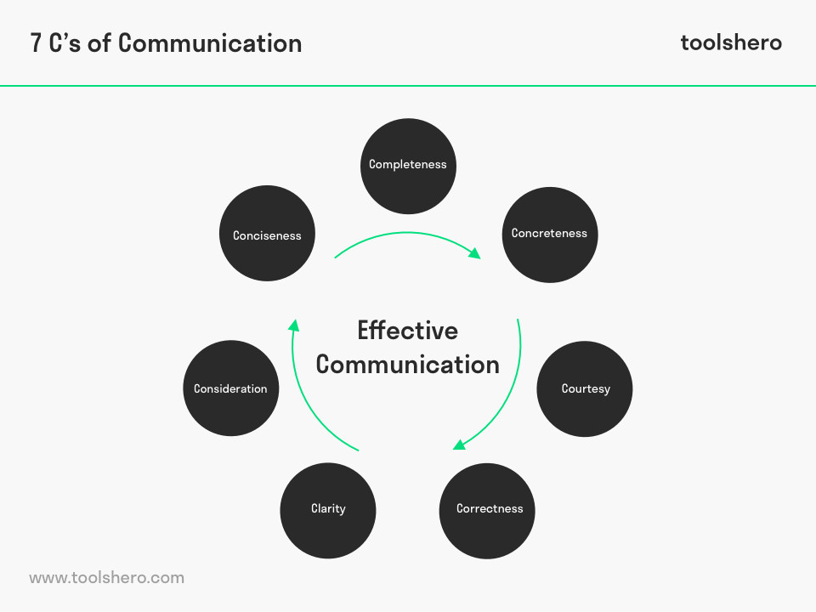

Slide 13
Types of Oral Communication
Interactive – (face-to-face conversation, interview, phone calls – chance to ask for clarification, request)
Partially interactive – (giving speech or presentation, check comprehension from audience’s faces)
Non-interactive (recording, performing in a play, singing, reciting a poem)

Slide 14
Examples of oral communication
Stage fright
Vote of thanks
Introduction of chair person
Chair person’s remarks
Proposal of toast
Welcome address
Telephone conversation
Interview
Class presentation
Public speech
Debate

Slide 15
Public Speaking: Stage Fright
The term “public speaking” no longer refers to just talking in front of a physical audience. It can also mean presenting to a virtual audience through online events, meetings, conferences.
“I hate speaking in front of large groups of people, yet I love picturing the standing ovation after delivering a great speech” (Daniel Waas)
If you’ve ever seen a documentary about people with phobias, they’re always told to face their fears. So after trying to think of anything other than doing just that, I challenged myself to go and speak at large events in order to overcome my fear of public speaking. (Daniel Waas)

Slide 16
COMMON FEARS WHEN IT COMES TO PUBLIC SPEAKING
Looking like a fool
Boring the audience
Being lost for words
People noticing your nervousness
People hating the presentation or, worse, getting up to leave

Slide 17
Stage fright(Glossophobia) : What is it ?
Stage Fright or Performance Anxiety is a state of fear or shyness which occurs when an individual is faced with the requirement of performing in front of and audience (either directly or through a screen in front a camera).
Stage fright is a fear to perform publicly.
It is group of disorders affecting individuals in a range of endeavours, such as public speaking, sports, performing arts in dancing, acting, and music making.
Stage fright can affect not only public speakers but all kinds of people who have to appear in front of an audience- musicians, dancers, politicians, or athletes etc.

Slide 18
Signs/Symptoms of Stage Fright
Symptoms of stage fright can occur at different levels:
Psychological – Sweating, altered heart rate, headache, upset stomach, chills, nausea
Cognitive- congestion and mental confusion, fear of failure and ridicule.
Behavioural- Urge to escape from the situation, stuttering, frequent and long silence.

Slide 19
Controlling Stage Fright
Try not to obsess about being perfect (No one is perfect)
Know your material- Choose a topic that you are really passionate about or familiar with. Make sure you know all about the topic by reading around it to be confident that the information is all accurate.
Prepare Your Environment In Advance So You Can Concentrate On Delivery
Laptop/tablet, microphone ,projector or display, presentation clicker, lectern power socket to plug in your laptop
Practise some more- Regular Practise creates familiarity and bring comfort.
Watch yourself- It is a good to practise in private( in front of a mirror or in a quiet room and watch yourself perform. Record performance and analyze your onstage movement.

Slide 20
Controlling Stage Fright Cont.
Prepare Notes- If you are allowed, type up your notes or write them out to have an easy-to-see notes with you. If you freeze up and forget some information, you will have a solid safety net that you know you depend on.
Bring something to hold onto- Most people fidget when they are nervous so bring that you can channel your anxiety towards. If you do not have a podium to stand behind, try to find a clipboard, notebook, or a stack of papers.
Learn from others- Observe top performers to decide what is about the way to perform (their movement, body language, how they interact with the audience etc. Observing top performers with great stage presence inspires and helps you develop your own onstage persona.
Do not hurry through it-. Speaking quickly is associated with hurried breaths with fear and panic.

Slide 21
Chairperson’s Remarks
Chairperson’s remarks come after they have introduced and after the main programme. In the first marks, the chairperson has to:
Greet guests informally by using light-hearted language: Choose a simple and
straightforward greeting such as, "Good morning everyone!"
Express your gratitude towards the guests for attending the programme by using a phrase such as, "It's so wonderful to see you all here on this special day
Keep the tone more serious if it's an important occasion: Use more formal language and don't crack any inappropriate jokes.
Introduce the event itself: Provide a short introduction to the name and purpose of the event.
Prepare the minds of guests by giving the assurance: Say that you hope the audience enjoys the event.
Pass on your warm wishes to the audience for the rest of the event.

Slide 22
Chairperson’s Remarks
In the after the programme remarks, the chairperson should briefly:
Acknowledge those who have played an important part in the event. Mention 2-3 people who have helped to turn the event from an idea into reality. State their names and the role that each person played.
Avoid reading off a long list of people or sponsors, as your audience will begin to get bored. Stick to just a handful of highlights.
Mention any parts of the event that are of special importance.
Pick the parts that are the most important, and give people encouragement about anything they should stick around for or pay special attention to.
Thank the audience for attending the programme. Say a brief sentence or 2 expressing your gratitude on behalf of the event.
Keep it short and to the point. For example at an informal event you could say, "Thank you to everyone here for coming along tonight."

Slide 23
Thanking/Thanksgiving
Thanking/Thanksgiving is one of the major types linguistic routines- greetings, apology, request, thanking, recounting one’s mission etc.
Thanking is an expressive speech act that states what the speaker feels. Thanks are rituals employed in communicative encounters to mark the closing of events such meeting, public debate, lectures, seminars, workshops, invitation to wedding etc.
After each of the following communicative events, the speaker will say “thank you for listening and/or thanks for coming.
Ritualized and institutionalized thank are predictable hence, when one fails to render thanks, it brings annoyance. Thanks serve as a linking line between giving and receiving and it is a symbol of love.
The ability to say thank you in any form is a mark of communicative competence, depicting how polite one is and brings a bond of social cohesion and solidarity among the benefactor and the beneficiary (Agyekum 2011).

Slide 24
Vote of Thanks
Vote of Thanks is part of an agenda of any organized programme where some people are designated to express gratitude to God, the participants and the organizers and sponsors of the programme.
Vote of thanks requires that dignitaries, functionaries (organizers, MC, musicians etc.) are acknowledged for the part they played in the function.
The speaker is advised to go straight to the point, mentioning names of identifiable groups, special personalities, individuals and thank them for what they did. In a very formal occasion, thanking God may not be necessary, leave that to closing prayer.

Slide 25
Formal Vote of Thanks
A formal vote of thanks to a speaker is a mark of courtesy. Sincerity is the key word when putting forward vote of thanks.
This depends on the genuine assessment of the positive and helpful aspects of the speech.
It is useful to refer to the speaker’s wit and wisdom, the precise and frank manner in which he/she has dealt with the subject matter, and indicate the great interest which you (audience) have had in particular portion of his/her speech.
Mention briefly one or two points to indicate that you have really taken them in, and show assurance of practicing them.
It would be appropriate if the introduction is made without using the traditional words like “ I am happy to be called upon to give the vote of thanks”

Slide 26
Example of formal vote of thanks
This is very memorable to all of us here because of the valuable information that we have received from our special resource person. He has given us more than enough of what expected to know on this important topic. You will agree with me that he deserves our sincere appreciation for sharing with us all the issues that we were yearning for. He has succinctly explained the need to take our learning seriously and the need to observe all the protocols of the COVID 19 to reduce the spread of the virus. His in-depth analysis of this topic will leave with us long lasting memories. This will go a long way to instil in us the spirit to learn hard and to observe all the COVID protocols.
We also express our thanks to all those who have in diverse ways contribute to make programme a fruitful one.
Thank You

Slide 27
Proposal of Toast: What is it?
To wish a person future health, happiness, and success and ask others to raise their glasses and join in a drink
A toast is proposed on the occasions of birthdays, weddings, anniversaries, ceremonies, etc.

Slide 28
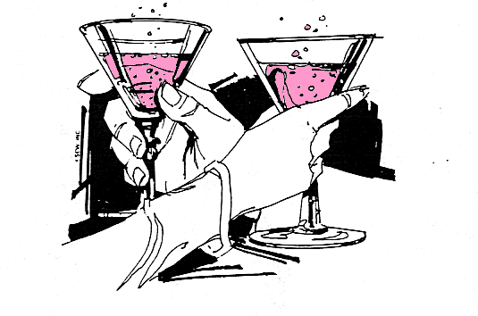
Proposal of Toast
Proposal of Toast on occasions of anniversaries of business or personality requires that:
mention is made of the reason for the occasion
a very brief history is given about event
mention is made of some challenges and achievements
mention few names who made it possible for the achiements
call on audience to toast them into the future.

Slide 29
How to propose a toast
Be prepared.
Know your audience. (Ask yourself, what would they like to hear from me?)
Keep short and sweet (be brief)
Catch your audience attention (stand by a chair and raise your voice while you hold your glass)
When mentioning names of persons or places be sure they are correct and you pronounce them properly.
Give substance to your remarks. A good toast can be enriched with a few words of wisdom
Be witty but never vulgar
Don’t get drunk

Slide 30
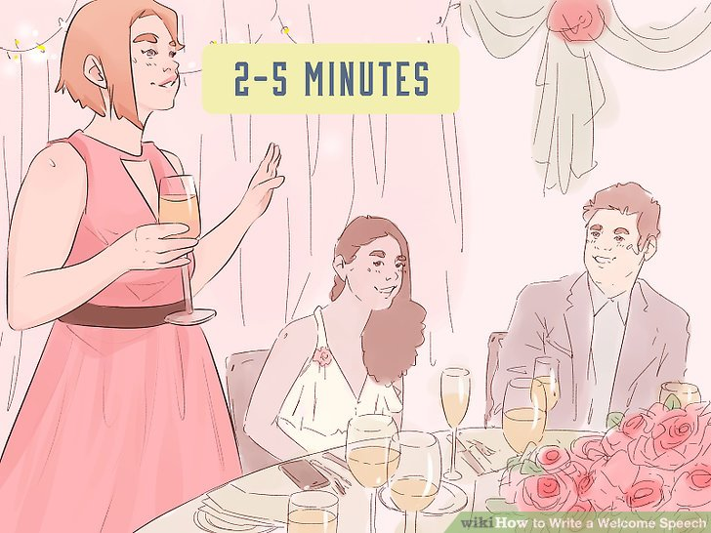
Proposing a toast

Slide 31
Telephone Conversation
Telephone is one of the most commonly used means of oral communication.
Telephone is used to: place and take orders, exchange needed information, make appointments, establish valuable business contacts, etc.
It provides instant feedback
It save communication time.

Slide 32
Efficient use of the telephone
Introduce yourself, ask them to introduce themselves, speak clearly, do not rush, ask them to speak for clarity and end in a definite way.
Be brief- Do not become loquacious
Be courteous- Show respect to all.
Be resourceful- Always decide to help others
Speak clearly and audibly- Speak naturally and audibly.
Actively listen and take notes.
Remain cheerful- smile when you talk to people
Make the caller feel welcome
Do not shout or whisper- being overtly loud or overtly quiet can make the conversation awkward.
Do not leave caller on hold for too long.
Don’t get distracted by the room or people around- Avoid asking your callers to repeat themselves over and over.
Limit background noise

Slide 33
Efficient use of the telephone cont.
Make sure not to hang up by accident
Don’t use poor equipment- Phone equipment that always disconnecting, dropping calls or having full of interferences will not help.
Do not answer anonymously- Calling a strange company can be a bit off-putting for your customers

Slide 34
INTERVIEW
An interview is a selection process designed to obtain information from a person through oral responses to oral inquiries.
An interview is a conversation (face-to-face) between the interviewer and the interviewee, where the interviewer seeks replies from the interviewee for choosing a potential human resource.
Interview is a selection procedure designed to predict future job performance on the basis of applicants’ oral responses to oral inquiries. The interview is the most critical component of the entire selection process.

Slide 35
Importance of interview
It serves as the primary means to collect additional information on an applicant.
It serves as the basis for assessing an applicant’s job-related knowledge, skills, and abilities.
It is designed to decide if an individual should be interviewed further, hired, or eliminated from consideration.

Slide 36
Types of Interview
There are several types of interview:
Unstructured /Nondirective Interview.
Structured /Directive Interview.
Situational Interview.
Behavioral Interview.
Job-related Interview.
Stress Interview.
Panel Interview /Board Interview
One-On-One Interview.
Mass Interview /Group Interview
Phone Interview

Slide 37
Unstructured/Nondirective Interview
An unstructured interview is an interview where probing, open-ended questions are asked. It involves a procedure where different questions may be asked to different applicants.
In unstructured interviews, there is generally no set format to follow so that the interview can take various directions.
The lack of structure allows the interviewer to ask follow-up questions and pursue points of interest as they develop.

Slide 38
Structured/Directive Interview
In structured interviews, the interviewer lists the questions and acceptable responses in advance and may even rate and score possible answers for appropriateness.
An interview consisting of a series of job-related questions that are asked consistently of each applicant for a particular job is known as a structured interview.
A structured interview typically contains four types of questions.
Situational questions: Pose a hypothetical job situation to determine what the applicant would do in that situation.
Job knowledge questions: Probe the applicant’s job-related knowledge.
Job-sample simulation questions: Involve situations in which an applicant may be actually required to perform a sample task from the job.
Worker requirements questions: Seek to determine the applicant’s willingness to conform to the requirements of the job.

Slide 39
Behavioral Interview
In a behavioral interview, you ask applicants to describe how they reacted to actual situations in the past.
Candidates are asked what actions they have taken in prior job situations that are similar to situations they may encounter on the job. The interviewers are then scored using a scoring guide constructed by job experts.
This is a structured interview that uses questions designed to probe the candidate’s past behavior in specific situations. This technique involves asking all interviewees standardized questions about how they handled past situations that were similar to situations they may encounter on the job.
The interviewer may also ask discretionary probing questions for details of the situations, the interviewee’s behavior in the situation, and the outcome. The interviewee’s responses are then scored with behaviorally anchored rating scales.

Slide 40
Job-related Interview
In a job-related interview, the interviewer asks applicants questions about relevant past experiences. It is a series of job-related questions that focus on relevant past job-related behaviors. The questions here don’t revolve around hypothetical or actual situations or scenarios.
Instead, the interviewer asks job-related questions such as, “Which courses did you like best in business school?”

Slide 41
Stress Interview
In a stress interview, the interviewer seeks to make the applicant uncomfortable with occasionally rude questions. The aim is supposedly to spot sensitive applicants and those with low or high-stress tolerance.
Stress interviews may help unearth hypersensitive applicants who might overreact to mild criticism with anger and abuse. It intentionally creates anxiety to determine how an applicant will react to stress on the job.

Slide 42
Panel Interview (Board Interview)
A panel interview, also known as a board interview.
It is an interview conducted by a team of interviewers, who together interview each candidate and then combine their ratings into a final score.
Here one candidate is interviewed by several representatives of the firm. This technique entails the job candidate giving oral responses to job-related questions asked by a panel of interviewers.
Each member of the panel then rates each interviewee on such dimensions as work history, motivation, creative thinking, and presentation.
The scoring procedure for oral interview boards has typically been subjective; thus, it would be subject to personal biases of those individuals sitting on the board.
This technique may not be feasible for jobs in which there are a large number of applicants that must be interviewed.

Slide 43
One-On-One Interview
In a one-on-one interview, one interviewer meets one candidate.
In a typical employment interview, the applicant meets one-on-one with an interviewer.
As the interview may be a highly emotional occasion for the applicant, meeting alone with the interviewer is often less threatening.

Slide 44
Mass Interview (Group Interview)
The mass/group interview is a relatively new technique in the west and almost unknown in our country. It is a procedure for the discovery of leadership.
Several job applicants are placed in a leaderless discussion, and interviewers sit in the background to observe and evaluate the performance of the candidates.
In a mass/group interview, a panel interviews several candidates simultaneously. The panel poses a problem and then watches to see which candidate takes the lead in formulating an answer.

Slide 45
Other types of interview
Appraisal Interview: An appraisal interview is to assess the performance of employees and progress made. It is normally conducted annually.
Promotion Interview: Promotion interview is to assess the suitability of internal employees for higher position.
Counseling Interview: Counseling interview is to help employees overcome their emotional or other kinds of problems.

Slide 46
Preparing for an interview
In an interview, the applicants ‘market’ their skills, abilities, knowledge and personality to the employer, so preparation is very important.
Since selection interview aims at choosing the right applicant, the interview will enable the interview panel to choose the candidate who satisfies requirement on.
Comportment
Manners
Speech
Intelligence
Judgment
Initiative
Resourcefulness
Assurance
Commonsense

Slide 47
Preparing for an interview – Before the interview
Prepare for the interview by researching the background of the company or the organization: history, aims, organizational structure, turnover, service or product, priorities, location, competitors, etc.
Put your CV, certificates, and other documents together.
Think about possible questions that you are likely to be asked and prepare for possible answers for them.
You may search for the venue of the interview

Slide 48
Preparing for an interview- Interview Day
On the day of the interview, arrive early at the venue.
Your interview begins the moment you step inside the organization.
Be courteous and friendly towards everyone you meet starting with receptionist.
Be mindful of your appearance: dress neatly, decently and comfortably in tune with the company and the position you are apply for.
Take with you the original certificates and other necessary documents.

Slide 49
During the interview
It is natural to feel a little nervous before an interviewer but try to relax as much as you can.
Greet the interviewers and sit comfortably in the chair reserved for you.
Avoid any sign of unpreparedness before the interviewers; nodding and shaking head, biting of fingers, hitting the table etc.
Pay attention to the interviewers and listen attentively to questions being asked.
Answer questions in a clear and audible voice.
Be tolerable to the interviewers and avoid unnecessary arguments with them.
Show politeness throughout the interview process.
Ask for clarity if you don’t understand or not clear about the question
Thank the interviewers before you leave the room.

Slide 50
After interview
Do critical self evaluation
Do follow-up

